Slide 1
Communication Systems

Slide 2
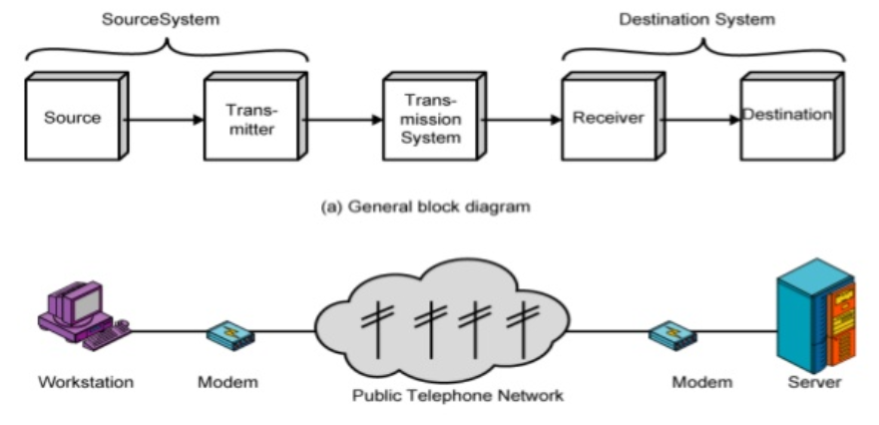
Introduction to Communication System
Enables exchange of information between the sender and the receiver

Slide 3
Components of a Data Communication System
Source: Sender of information
Transmitter: Converts information into a suitable form for transmission, e.g. by modulation and amplification
Channel: Medium through which the signal travels (wired - copper or fiber-optic cables or wireless - radio waves, microwaves, or infrared)
Receiver: Receives the transmitted signal and converts it back into a form that can be understood by the destination, e.g. by demodulation
Destination: Receiver of the transmitted information

Slide 4
Issues in Computer Networking
Bandwidth Limitations
Latency
Packet loss
Network congestion
Security threats
Data privacy
Scalability
Interoperability
Network management
Quality of Service

Slide 5
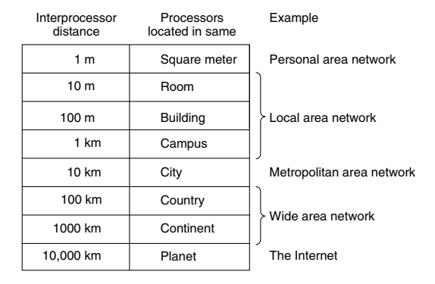
Network Types

Slide 6
Local Area Network (LAN)
Local Area Network (LAN): A privately owned network that operates within a single building like a home, office or factory
Wireless LANs: Every computer has a wireless modem and an antenna that it uses to communicate with other computers
An access point or base station controls the network
IEEE 802.11 standard (also called WiFi) describes this

Slide 7
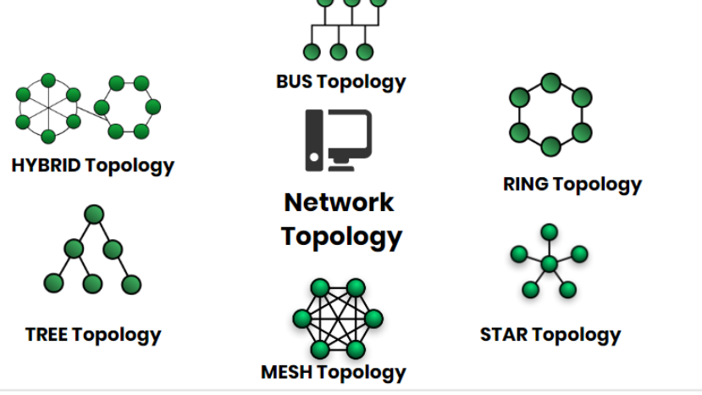
Network Topology
Network Topology represents a network arrangement consisting of several nodes

Slide 8

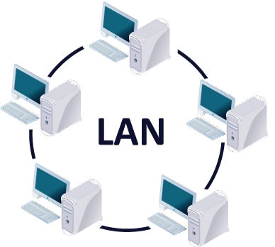
Network Interface Card (NIC)
Network Interface Card (NIC): Interface between a computer and a network
Also called LAN card
Has a hardcoded address: MAC address, Physical address, Hardware address
Speed:
Classical Ethernet: 10 Mbps
Fast Ethernet: 100 Mbps
Gigabit Ethernet: 1000 Mbps = 1 GBPS
NIC

Slide 9
Ethernet
Wired LAN technologies: Ethernet, Token Ring, Token Bus
Most popular: Ethernet
Ethernet generations
Classic/Standard Ethernet (10 Mbps)
Fast Ethernet (100 Mbps)
Gigabit Ethernet (1 Gbps)
10 Gigabit Ethernet (10 Gbps)

Slide 10
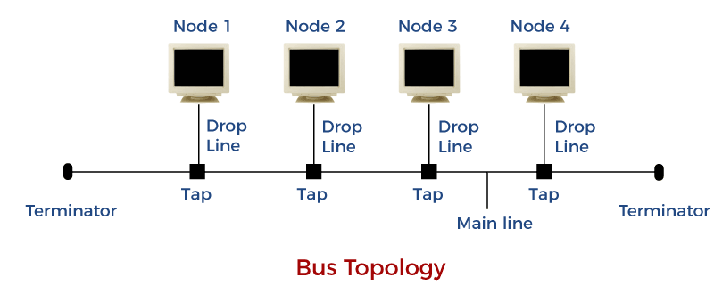
Bus Topology
All the nodes are connected to a common wire, called as bus
Simple and cost-effective, but all depends on a single cable, not fast

Slide 11
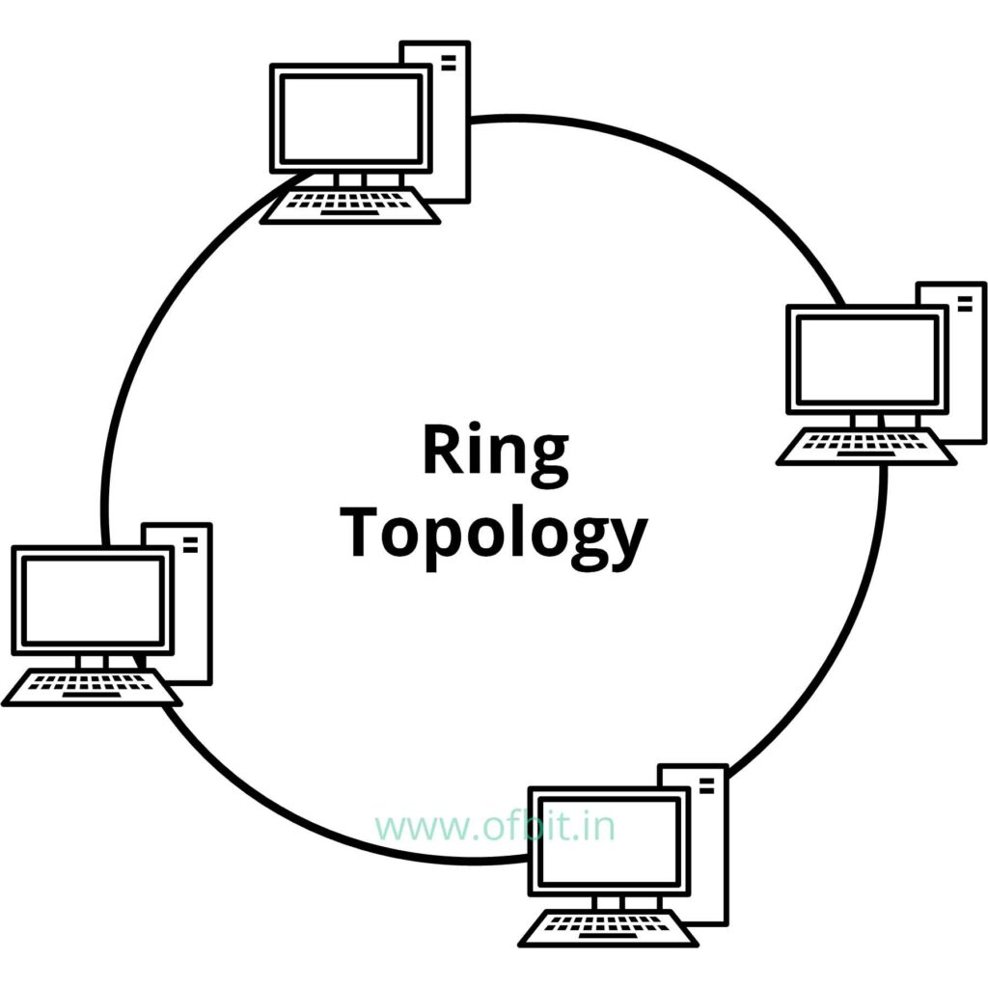
Ring Topology
One computer is connected to the next, and so on, to complete a ring
A transmitting computer needs to have a token, before transmitting
Inexpensive, Tough to add or remove nodes, One node crashing can disconnect the whole network

Slide 12
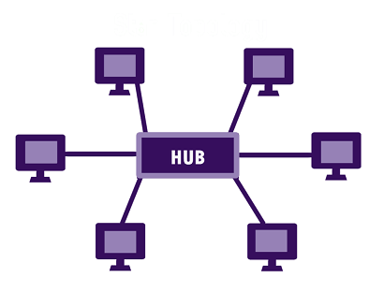
Star Topology
Each device is connected to a central hub
All communication goes through the hub only
Simple, too much of dependence on the hub, but the hub can be upgraded easily, Easy to troubleshoot, Cost is high

Slide 13
Ethernet – Earlier and Now
Classic Ethernet (Bus topology)
Carrier Sense Multiple Access with Collision Detection (CSMA/CD)
Allow any host to send data
If two hosts transmit at the same time, collision happens, Recovery: CSMA/CD
Gigabit Ethernet/Switched Ethernet (Star topology)
Switches are used to connect different computers
Switched Ethernet
Fast Ethernet: 100 Mbps
Gigabit Ethernet: 1000 Mbps (1 Gbps)
10 Gigabit Ethernet: 10,000 Mbps (10 Gbps)

Slide 14
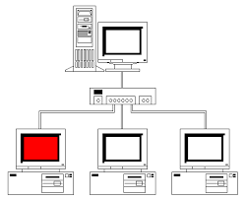
Switched Ethernet
Hosts connect into switches, and switches connect to each other
Ethernet switch

Slide 15
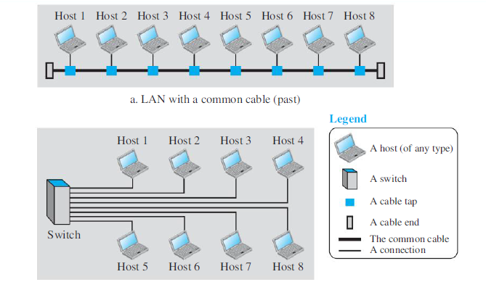
LAN – Earlier and Now

Slide 16
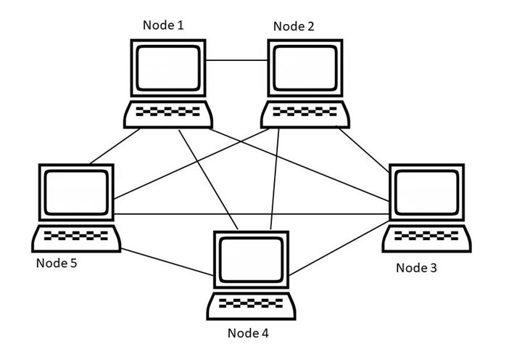

Mesh Topology
All nodes are connected to each other
Point-to-point connection, so for n nodes: $n x \left(n−1\right)÷2$ links
Very robust, Easy to diagnose errors, Privacy and security are better, Costly, Too much of wiring

Slide 17
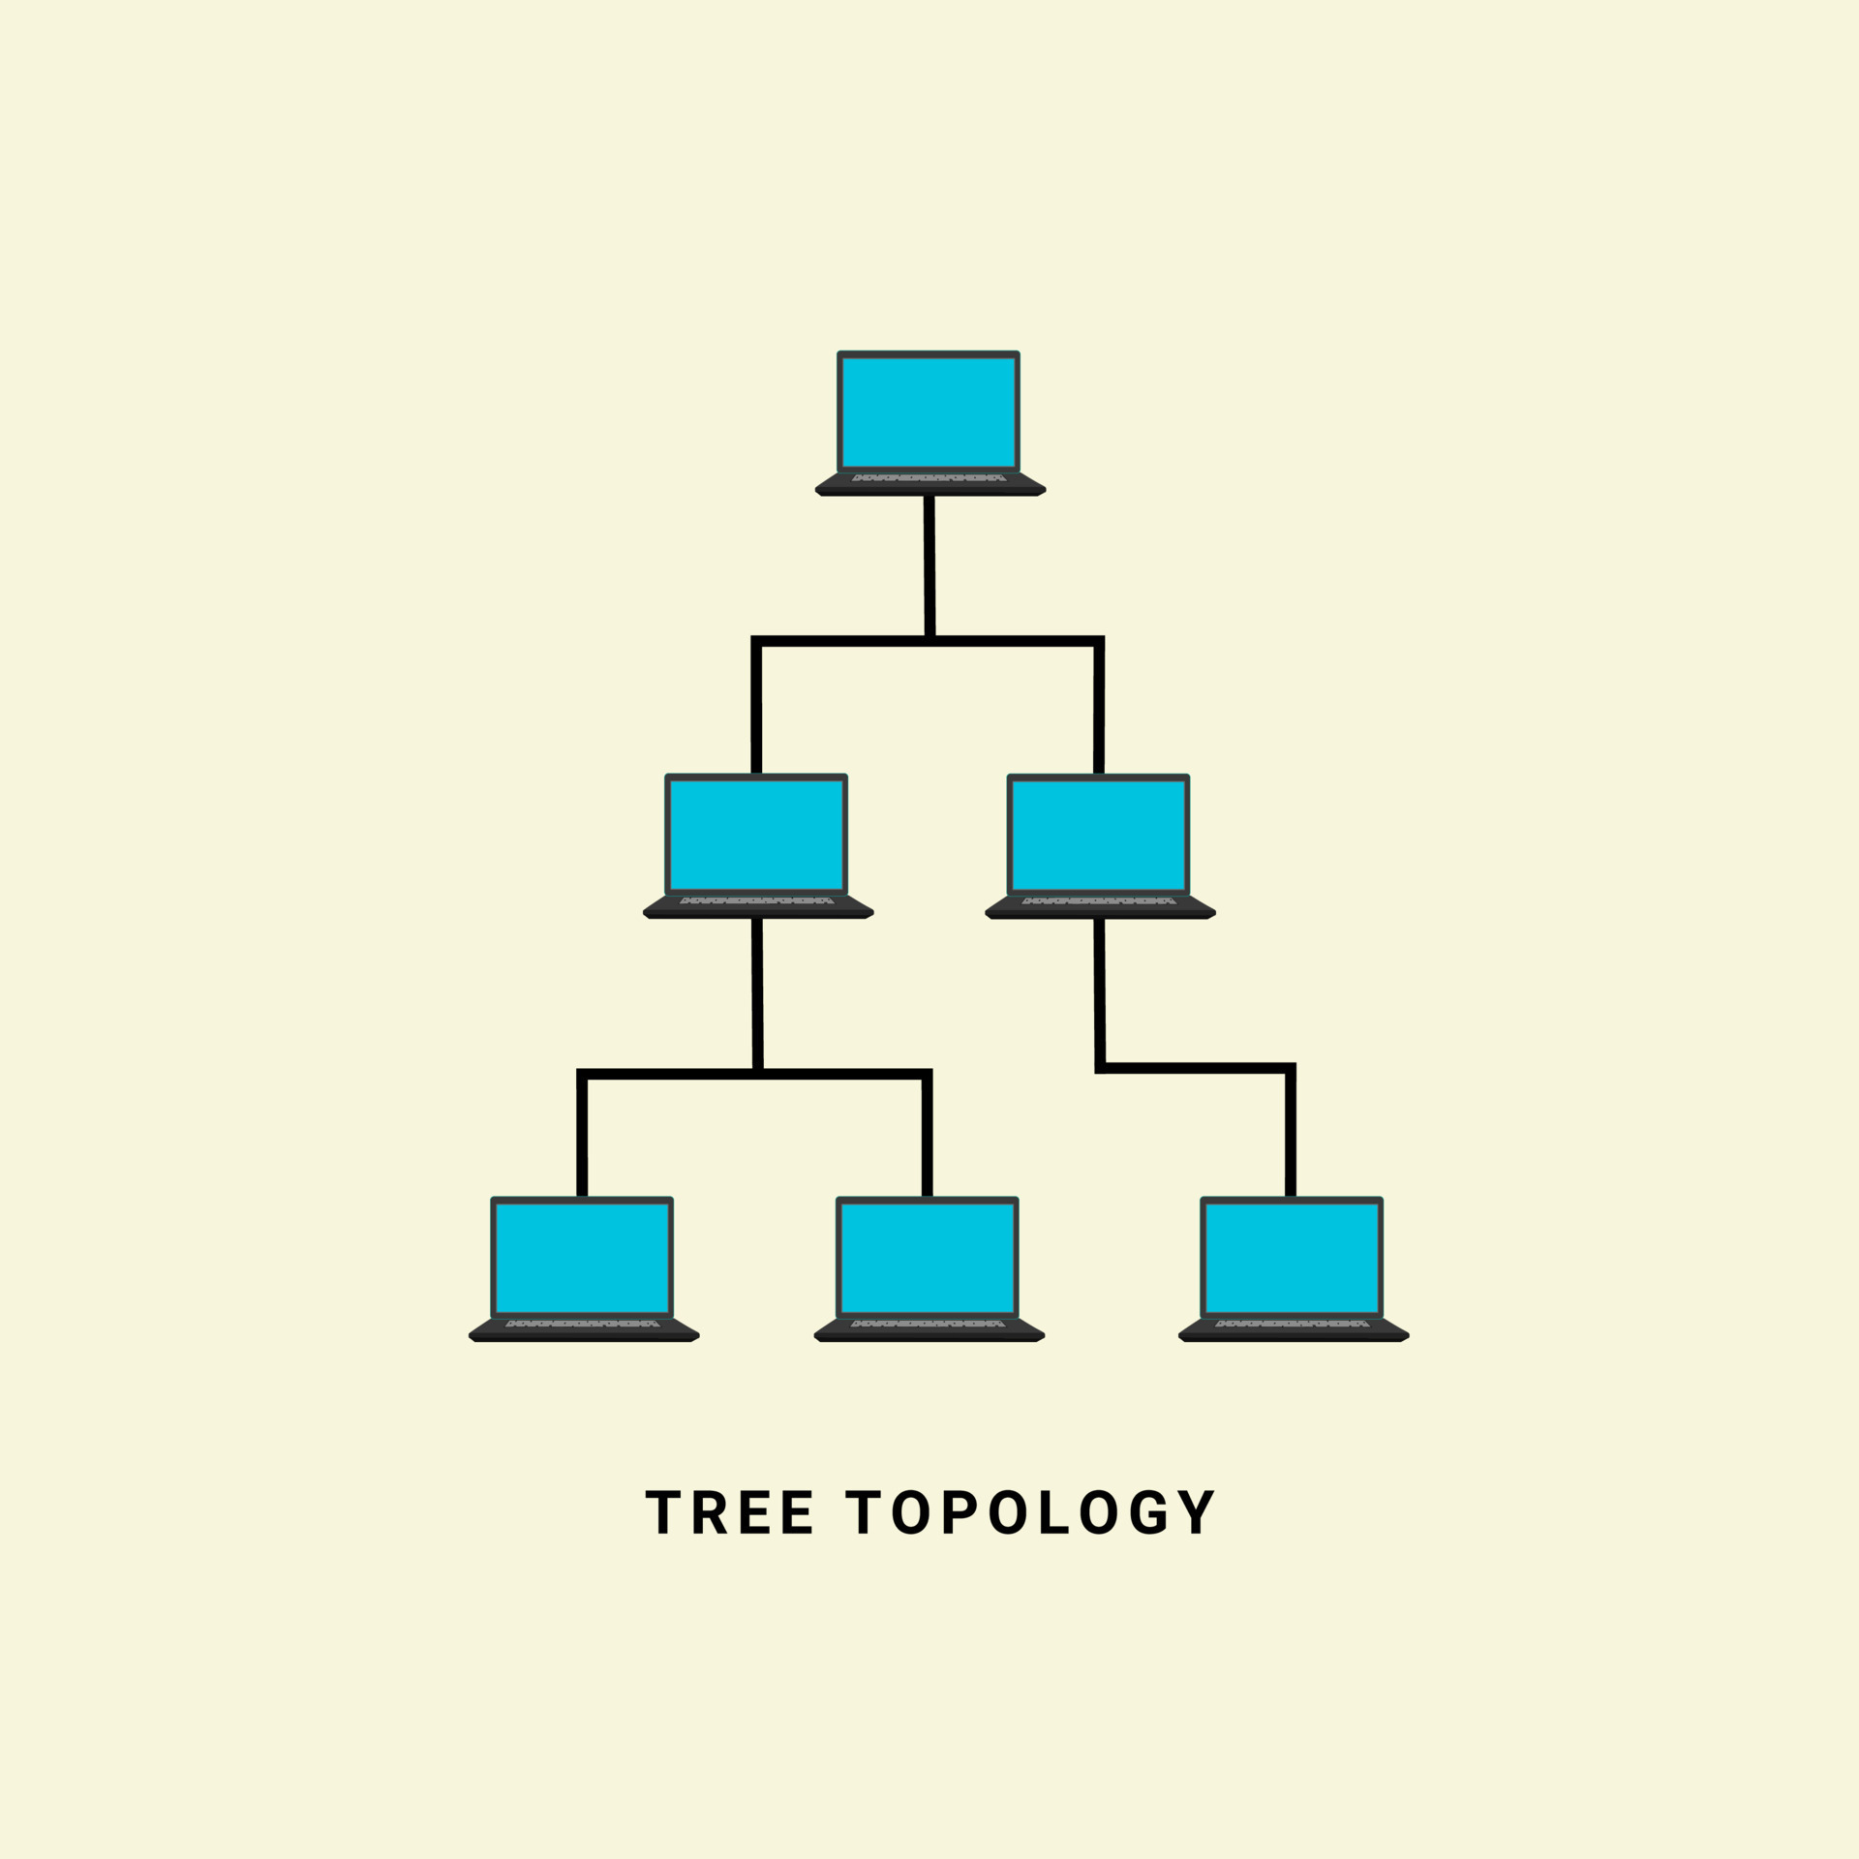
Tree Topology
Nodes are connected hierarchically, ultimately connecting to the top node, called as the root node
Has at least three levels of hierarchy
Easy to expand and manage, debug
Expensive, lot of cabling

Slide 18
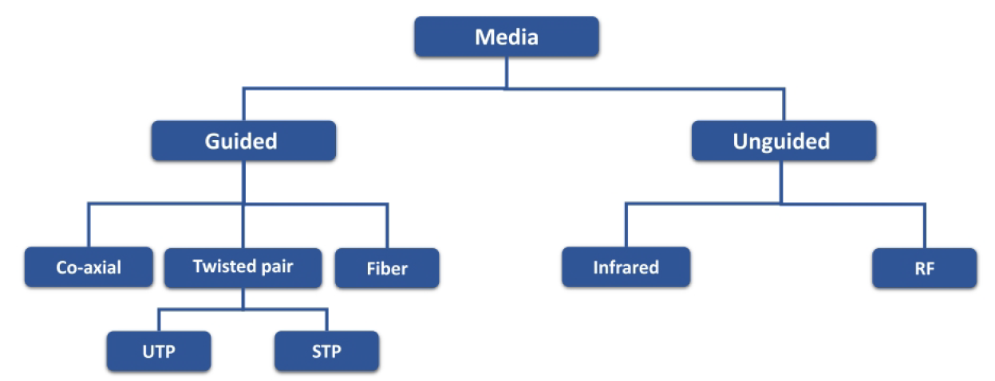
Transmission media

Slide 19
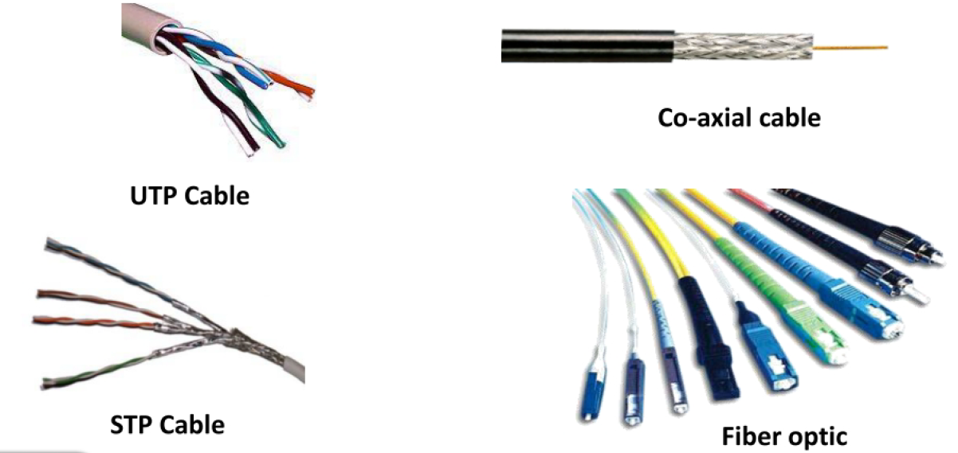
Transmission media

Slide 20
Transmission Media
Transmission medium: Carries information from a source to a destination
Guided media (Wired) include twisted-pair cable (uses electric current), coaxial cable (uses electric current), fiber-optic cable (uses light)
Unguided medium (Wireless) is air

Slide 21
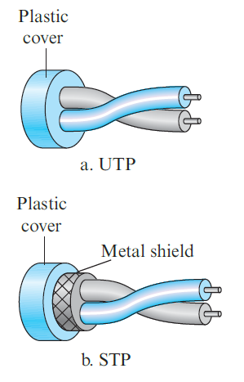
Twisted-pair cable
Consists of two copper wires
Two types
Unshielded twisted-pair (UTP)
Shielded twisted-pair (STP)
Used in telephone networks

Slide 22
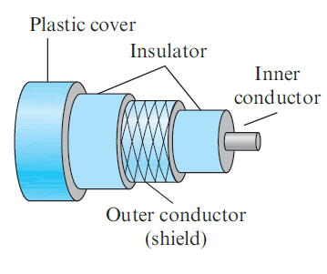
Coaxial cables
Coaxial cable (or coax) carries signals of higher frequency ranges than those in twisted-pair cable
Instead of having two wires, coax has a single copper wire
Usage: Telephone, Cable TV, LAN

Slide 23
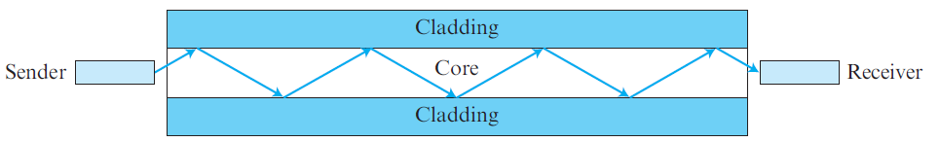
Fiber-optic cable
Made of glass or plastic and transmits signals in the form of light
Modern Ethernet is fiber optic-based

Slide 24
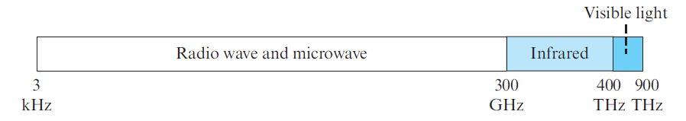
Unguided media
Use electromagnetic waves – no wire is needed
Also called as wireless communication
Signals are normally broadcast through free space and thus are available to anyone who has a device capable of receiving them
The part of the electromagnetic spectrum, ranging from 3 kHz to 900 THz is used for wireless communication.

Slide 25
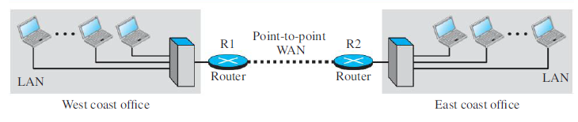
Wide Area Network (WAN)
A Wide Area Network (WAN) spans a large geographical area, often a country or continent
Example: Two LANs can be connected to form a WAN

Slide 26
Protocols

Slide 27
Protocol
Protocol: Set of official/implicit rules
Use: Communication between two people or two devices
Example: How to start a conversation, How to speak, What to say, How to end a conversation

Slide 28
Network Software
Network software uses a protocol stack
A protocol stack contains many layers or levels
Each layer provides some services to the layer above it
Each layer hides complexity of its work from the layer above it
Creates a protocol hierarchy

Slide 29
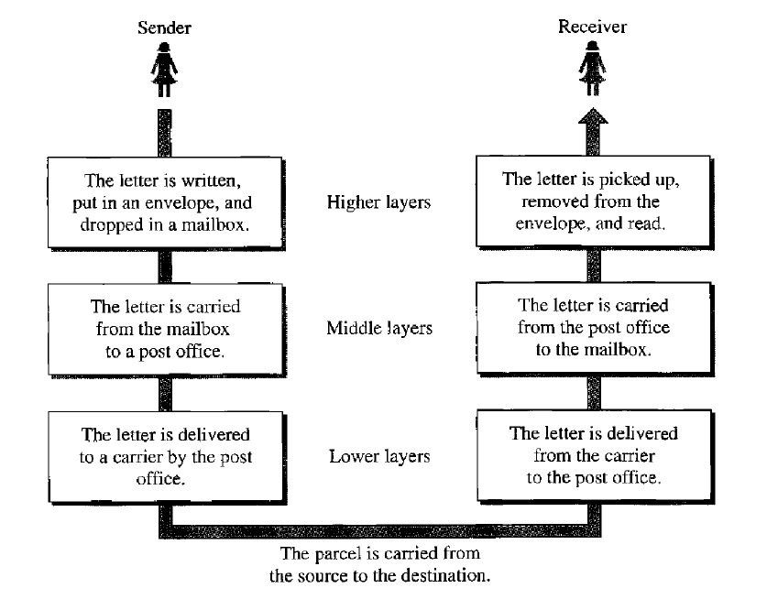
Protocol Hierarchy Example

Slide 30
OSI
Open Systems Interconnection
Good in theory, not used in practice
Contains 7 layers
Sometimes also called ISO/OSI
Application Layer
Presentation Layer
Session Layer
Transport Layer
Network Layer
Data Link Layer
Physical Layer

Slide 31
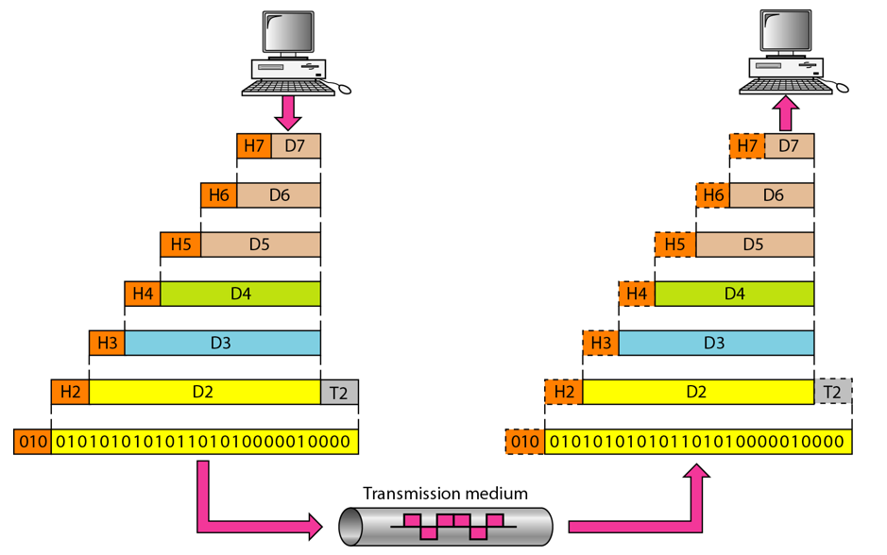
An Exchange using the OSI Model

Slide 32
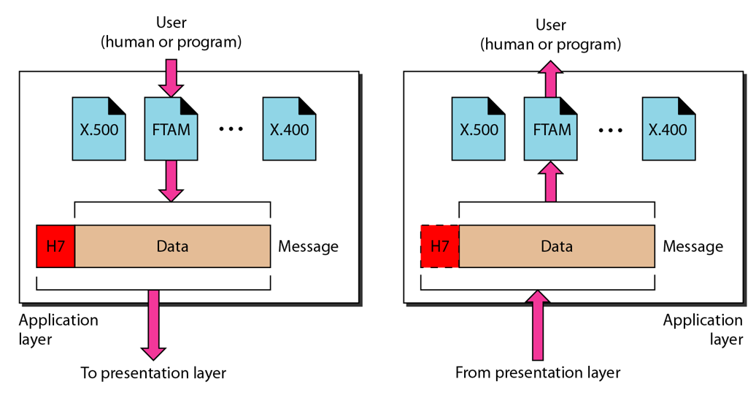
The Application Layer

Slide 33
Application Layer
Provides an “application view” to a network (e.g. email, file transmission)
Example: Hypertext Transfer Protocol (HTTP) is used to access Web pages
Encapsulation begins here
Other programs: Email (SMTP), File transfers (FTP), Querying domain names (DNS)

Slide 34
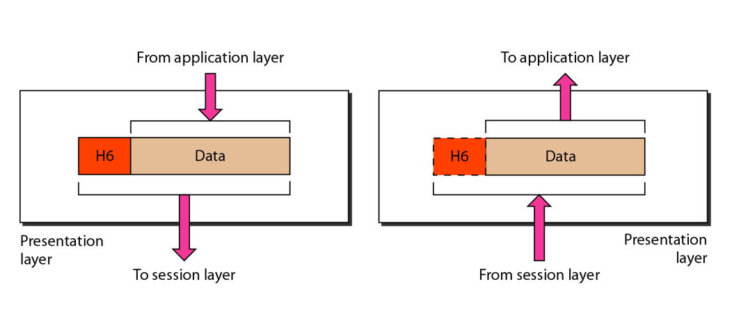
The Presentation Layer

Slide 35
Presentation Layer
Translation: Use of a common format to take care of differences (encoding, number representation etc)
Encryption: To achieve confidentiality or privacy
Compression: Reduces the number of bits needed to be transmitted

Slide 36
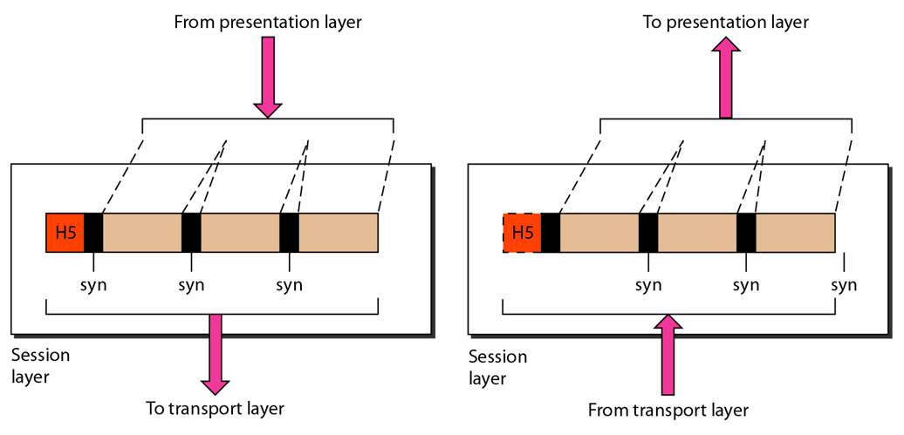
The Session Layer

Slide 37
Session Layer
Manages the session between applications
Example: Between browser of the source computer and server of the destination computer

Slide 38
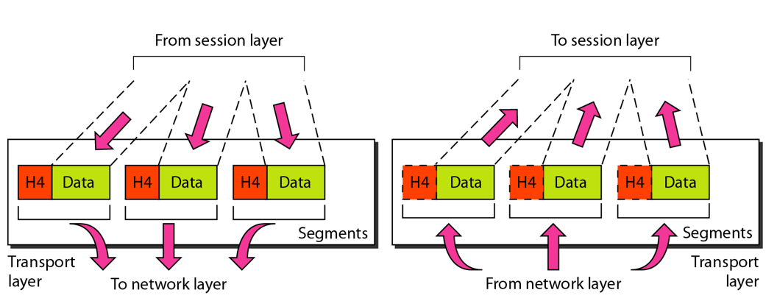
The Transport Layer

Slide 39
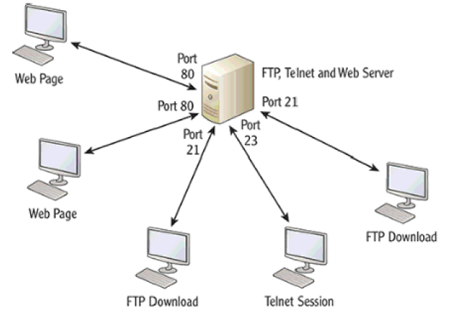
Transport Layer
Identifies the application on the destination computer using port numbers
Example: One server, multiple applications

Slide 40
Port Numbers
Port number is a 16-bit value, so it can store a number between 0 and 65,535
Port Number Range | Where used? | Called as
0-1023 | Server | Well-known ports
1024-49151 | Client | Temporary/Ephemeral
49152-65535 | NA | Dynamic, Usage-based

